Slide 1

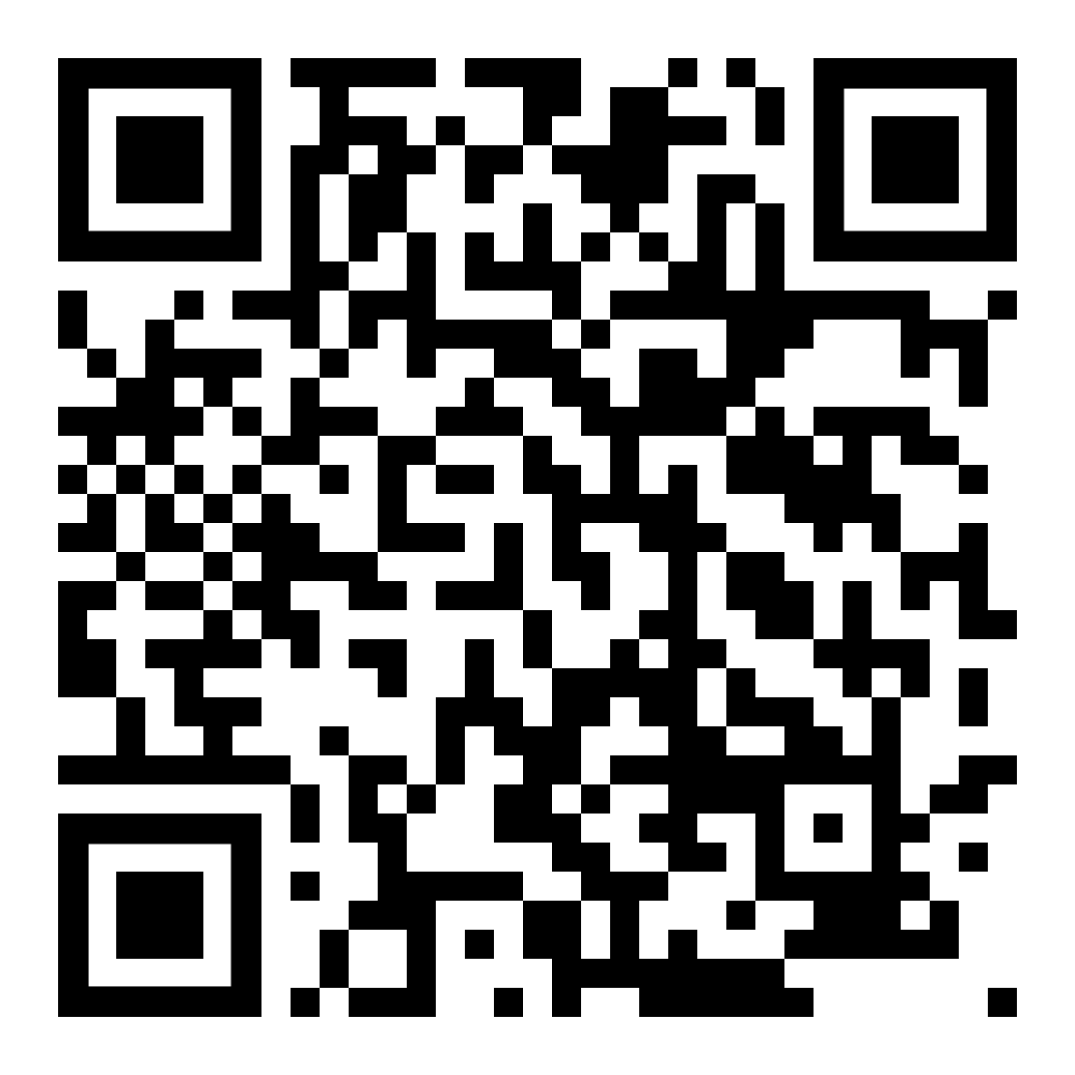
Member perks
Virtual dentistry
Remote consultations with a dentist
Healthcare Spending Card
No annual fee card through Lane Health¹ provides exclusive access to 12-month, 0% financing for dental expenses and more²
Hearing aids and LASIK
Discounts through Amplifon and QualSight
LifePerks
Discounts on oral health products, services, memberships and more
Wellness resources
Online articles, recipes, videos and more
Extra features, exceptional outcomes
Members can learn more at www1.deltadentalins.com/memberperks
¹ Lane Health is a financial technology company, not a bank. The Healthcare Spending Card is issued by Lead Bank pursuant to a license from Visa USA Inc
² Lane Health does not charge interest on, or an annual fee for, the Healthcare Spending Card. Each Advance can be repaid in full,4-month term or 12-month term (with a minimum $3 due each payment period). Transactions other than qualified hospital or dental expenses (based on merchant category code) will be charged an origination fee of 5% and periodic finance fees. The location of the service provider is not determinative of whether a transaction is a qualified hospital expense. Rather, transactions made within or at a hospital (including but not limited to specialists, doctors, pharmacies, etcetera) are determined to be eligible by the associated MCC and not the location of the service provider in the hospital. New Advances, if eligible, can be repaid in full or over 4 installments with no origination or periodic finance fees. Late fees apply. You can review the fee table at https://lanehealth.com/hsc-lb-dd-feesdeltadentalins.com. Subject to credit line approval.
Opportunity may be subject to change without notice.
Notes:
PT24; 134907

